Slide 1
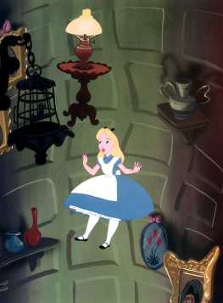
Recursion: to understand recursion, you first have to understand recursion.
Kurt Friedrich
Spring 2017

Slide 2
Think about the problem
Of finding a file in folder, that is inside of a folder, that is inside of another folder, etc.
Look at the next slides to visualize what you, a human would do. You are using recursion.

Slide 3
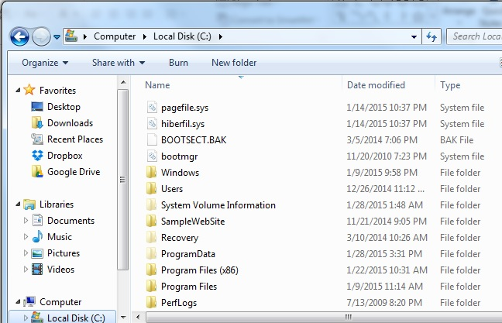
Looking for file wordpad.exe.mui you think it is somewhere under Program Files
So you double click that folder

Slide 4
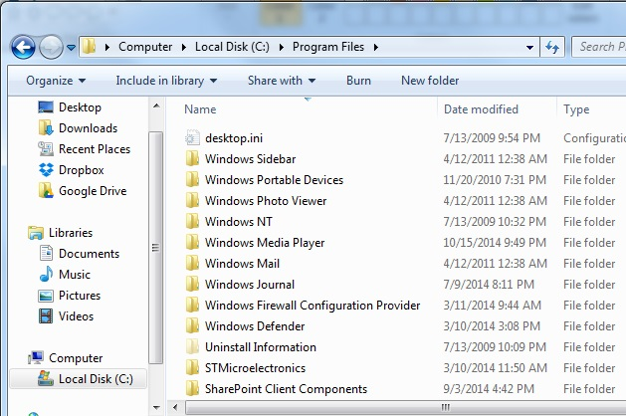
again you double click that folder

Slide 5
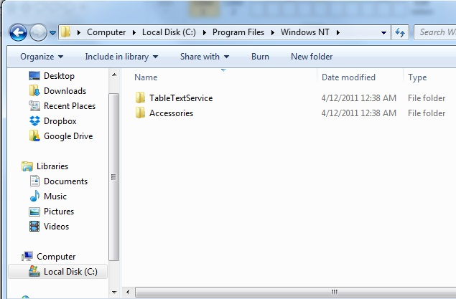
again you double click that folder

Slide 6
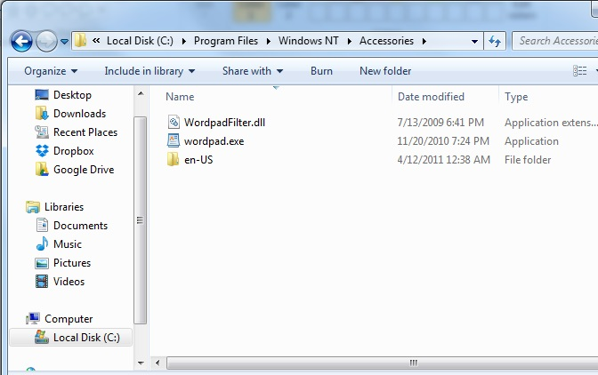
again you double click that folder

Slide 7
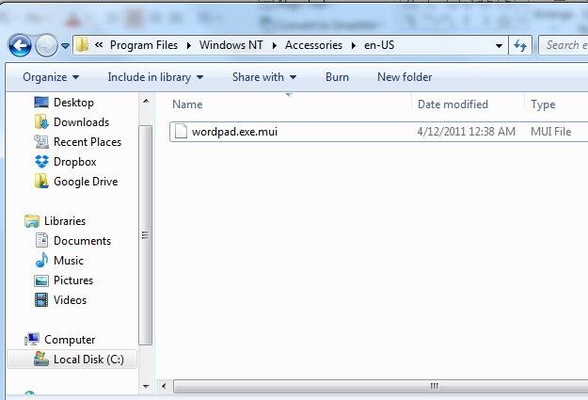
Found it! Filename = search string
This is the end of the recursion, as you meet a condition (found the file)

Slide 8
Yet another
A child couldn't sleep, so her mother told a story about a little frog,
who couldn't sleep, so the frog's mother told a story about a little bear,
who couldn't sleep, so bear's mother told a story about a little weasel
...who fell asleep.
...and the little bear fell asleep;
...and the little frog fell asleep;
...and the child fell asleep.

Slide 9
Recursion
Recursive code is done by writing a method, and that method calls itself, over and over again, until some end condition it detected, and then it returns its way over and over again, back to the initial call.
Each time it calls itself, the system saves that “level’s variables (on the stack) and then the next lower level uses its own unique variable values. So if it were to walk down 5 levels of calling itself, there will be 5 values for every variable in the method, all with the same name, but only one of them is “active”.

Slide 10
Recursion
A level is usually called a stack frame, as when it calls to the next level, the operating system’s stack is where the current level is preserved.
Usually each level of the recursive call does one increment of “useful work”. Depending on how the code is written, it might do that work just before it calls itself, or, it might to the work after it gets a return from this deep rabbit hole of calls.
Critical Concept: Each level you go down in recursion shrinks the problem by some amount.
When you look at someone else’s recursive code, its often very hard to keep track of what’s going on, so you need some strategy for making diagrams and notation on paper as you walk through the code.

Slide 11
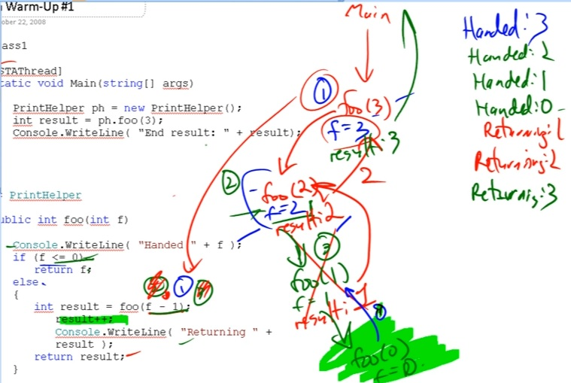
From a Michael Panitz video

Slide 12
Another possible scheme to keep notes
public int rec-method(4)
{
//do something
rec-method(16);
//do something
return
}
public int rec-method(16)
{
//do something
rec-method(256);
//do something
return
}
public int rec-method(256)
{
//do something
rec-method(); //assume done
//do something
return
}

Slide 13
http://www2.hawaii.edu/~tp_200/lectureNotes/recursion.htm
There are two key requirements to make sure that the recursion is successful:
Every recursive call must simplify the computation in some way.
3*3*3*3*3 => 3*3*3*3 => 3*3*3 => 3*3 => 3
There must be special cases to handle the simplest computations. (such as if the input is 0, so “done”)

Slide 14
Simplistic 1st example
Our first example will do nothing you could call “work”.
Instead, it just cycles down the rabbit hole
counting out as it ENTERS each new call to itself
And counting out as it leaves (returns) each level, coming back up the rabbit hole
So the only “work” it does, is flag its progress down and back up again.

Slide 15
Simplistic 1st example is at 1st-Recursion,but let’s build it ourself
static void Main(string[] args)
{
// instantiate an instance of the class
PrintClass myPrintClass = new PrintClass();
//call recursive method the 1st time from Main
int endResult=myPrintClass.recursionDemo(3);
// write out the value retuned
Console.WriteLine("End result: " + endResult);

Slide 16
The recursive method
public int recursionDemo(int f)
{
Console.WriteLine("Handed " + f);
if (f <= 0) // bottom of rabbit hole
{
return 10;
}
else
{
f = f - 1;
int result = recursionDemo(f); // what ????
result = result + 1;
Console.WriteLine("Returning " + result);
return result;
}
}

Slide 17
// as a bread crumb trail, write a
// line out before calling itself
Console.WriteLine("Handed " + f);
if (f <= 0) // recursive code needs a way to come to an
// end of the recursion, this one counts down
// the value passed in until it gets to zero
// only the very bottom iteration ever gets
// to execute this next line
{
return 10;
}
// 10 is just a value picked to be distinct from
// the counting down breadcrumb, which started at 1
// critical thing to understand,
// where is the above return statement returning to???

Slide 18
else
{
f = f - 1; // where we count down number of times to do the recursion
int result = recursionDemo(f); // calling >> our self! <<
// the next line keeps getting delayed (put on the call stack),
// as we jump away to another copy of our self
// when we hit the bottom of the recursion, we "unwind" our way back up, and
// do the WriteLine statement (below) each time we return back into our self
result = result + 1; // a way to see the order of how things happen.
Console.WriteLine("Returning " + result);
// and then go back up a level, with result being +1
return result;
}

Slide 19
Single step, watch the variables and the call stack
Enter 1st copy of recursionDemo’s: f = 3 … result = 0
Enter Else: f =2 … result = 0
Enter 2nd copy of recursionDemo’s: f = 2 … result = 0
Enter Else: f =1 … result = 0
Enter 3rd copy of recursionDemo’s: f = 1 … result = 0
Enter Else: f =0 … result = 0
Enter 4th copy of recursionDemo’s: f = 0 … result = 0
So “If” is now true, bottom of rabbit hole, set return to 10 return to 3rd level
3rd copy of recursionDemo’s, gets the return at 10, adds one, and returns to the 2nd copy
2nd copy of recursionDemo’s, gets the return at 11, adds one, and returns to the 1st copy
1st copy of recursionDemo’s, gets the return at 12, adds one, and returns to main
Main writes out the 13

Slide 20
http://www2.hawaii.edu/~tp_200/lectureNotes/recursion.htm
Both iteration and recursion
are based on a control structure: Iteration uses a repetition structure (i from 1 to 5); recursion uses a selection structure (until x >5).
involve repetition: Iteration explicitly uses a repetition structure; recursion achieves repetition through repeated method calls.
each involve a termination test: Iteration terminates when the loop-continuation condition fails; recursion terminates when a base case is recognized.
can run infinitely: An infinite loop occurs with iteration if the loop-continuation test never becomes false; infinite recursion occurs if the recursion step does not reduce the problem in a manner that converges on the base case.
Recursion repeatedly invokes the mechanism, and consequently the overhead, of method calls. This can be expensive in both processor time and memory space.

Slide 21
Recursion Versus Iteration http://www.programmerinterview.com/index.php/recursion/recursion-versus-iteration/
The fact is that recursion is rarely the most efficient approach to solving a problem, and iteration is almost always more efficient.
This is because there is usually more overhead associated with making recursive calls due to the fact that the call stack is so heavily used during recursion. This means that many computer programming languages will spend more time maintaining the call stack then they will actually performing the needed calculations.

Slide 22
Recursion Versus Iteration http://www.programmerinterview.com/index.php/recursion/recursion-versus-iteration/
Does recursion use more memory than iteration?
Generally it does because of the extensive use of the call stack.
Should I use recursion or iteration?
Recursion is generally used because of the fact that it is simpler to implement, and it is usually more ‘elegant’ than iterative solutions.
Anything that’s done in recursion can also be done iteratively.
But, depending on the problem that you are trying to solve, that performance drawback can be very insignificant – in which case it makes sense to use recursion.
With recursion, you also get the added benefit that other programmers can more easily understand your code – which is always a good thing to have.
We will look at a program, 8th-BtoP-Iterat-Recur later, and compare

